Slide 1
Linear Algebra Tutorial (Matlab/Octave/R)
Basic operations
Moving data around
Computing on data
Plotting data
Control statements: for, while, if statements
Vectorial implementation

Slide 2
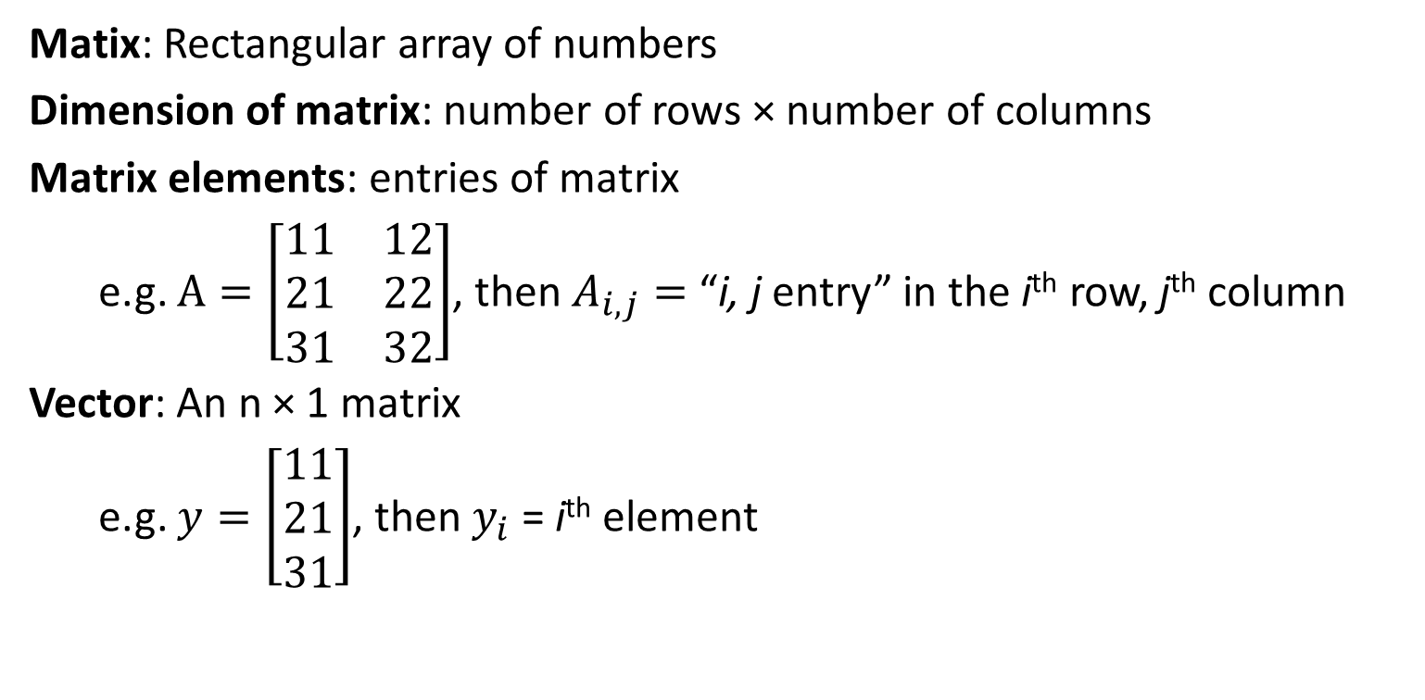
Matrices and vectors
Matix: Rectangular array of numbers
Dimension of matrix: number of rows × number of columns
Matrix elements: entries of matrix
e.g. $A=\left[\begin{matrix}11 & 12 \\ 21 & 22 \\ 31 & 32\end{matrix}\right]$, then $A_{i,j}=$ “i, j entry” in the i^{th} row, j^{th} column
Vector: An n × 1 matrix
e.g. $y=\left[\begin{matrix}11 \\ 21 \\ 31\end{matrix}\right]$, then $y_{i}$ = i^{th} element

Slide 3
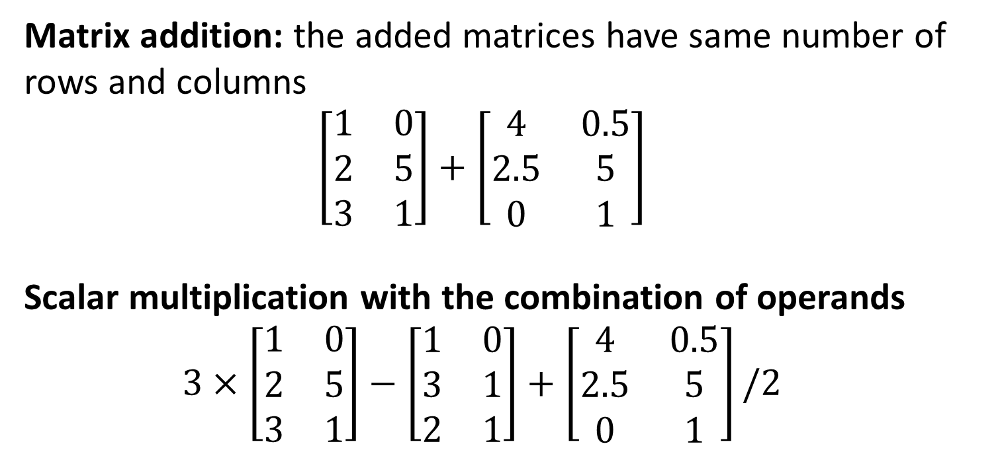
Addition and scalar multiplication
Matrix addition: the added matrices have same number of rows and columns
$$\left[\begin{matrix}1 & 0 \\ 2 & 5 \\ 3 & 1\end{matrix}\right]+\left[\begin{matrix}4 & 0.5 \\ 2.5 & 5 \\ 0 & 1\end{matrix}\right]$$
Scalar multiplication with the combination of operands
$$3×\left[\begin{matrix}1 & 0 \\ 2 & 5 \\ 3 & 1\end{matrix}\right]−\left[\begin{matrix}1 & 0 \\ 3 & 1 \\ 2 & 1\end{matrix}\right]+\left[\begin{matrix}4 & 0.5 \\ 2.5 & 5 \\ 0 & 1\end{matrix}\right]/2$$
A
B
C

Slide 4
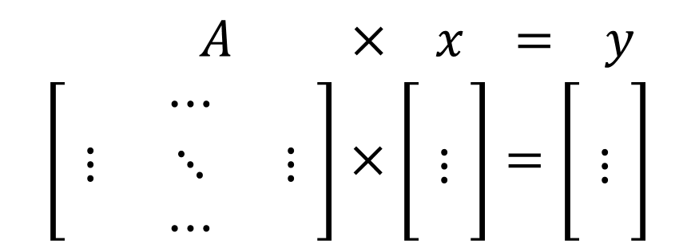
Matrix-vector multiplication
$A × x = y$
$$\left[\begin{matrix} & ⋯ & \\ ⋮ & ⋱ & ⋮ \\ & ⋯ & \end{matrix}\right]×\left[\begin{aligned}\begin{matrix} \\ ⋮\end{matrix} \\ \end{aligned}\right]=\left[\begin{aligned}\begin{matrix} \\ ⋮\end{matrix} \\ \end{aligned}\right]$$
m × n
matrix
n × 1
matrix
m × 1
matrix
m rows, n columns
m-dimensional vector
n-dimensional vector
To get $y_{i}$, multiply $A$’s i^{th} row with elements of vector $x$, and add them up.

Slide 5
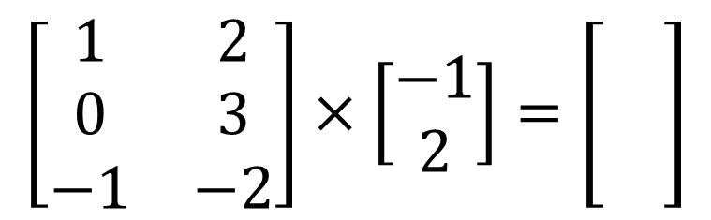
Matrix-vector multiplication
E.g.
$$\left[\begin{matrix}1 & 2 \\ 0 & 3 \\ −1 & −2\end{matrix}\right]×\left[\begin{matrix}−1 \\ 2\end{matrix}\right]=\left[\begin{matrix} \\ \\ \end{matrix}\right]$$

Slide 6
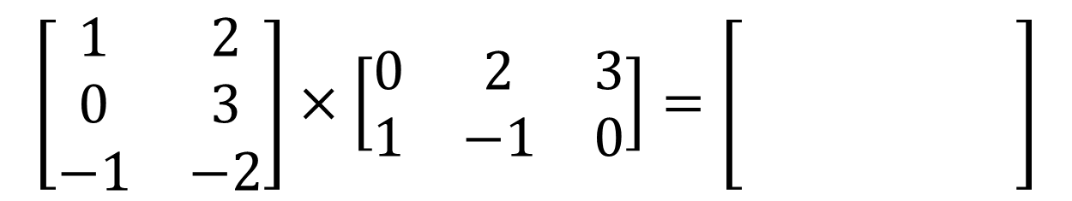
Matrix-matrix multiplication
E.g.
$$\left[\begin{matrix}1 & 2 \\ 0 & 3 \\ −1 & −2\end{matrix}\right]×\left[\begin{matrix}0 & 2 & 3 \\ 1 & −1 & 0\end{matrix}\right]=\left[\begin{matrix} & & \\ & & \\ & & \end{matrix}\right]$$
In R, %*% multiplies two matrices

Slide 7
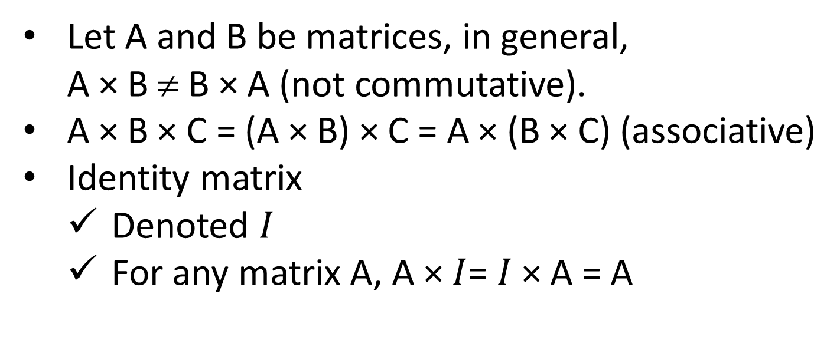
Matrix multiplication properties
Let A and B be matrices, in general,
A × B ≠ B × A (not commutative).
A × B × C = (A × B) × C = A × (B × C) (associative)
Identity matrix
Denoted $I$
For any matrix A, A × $I$= $I$× A = A

Slide 8
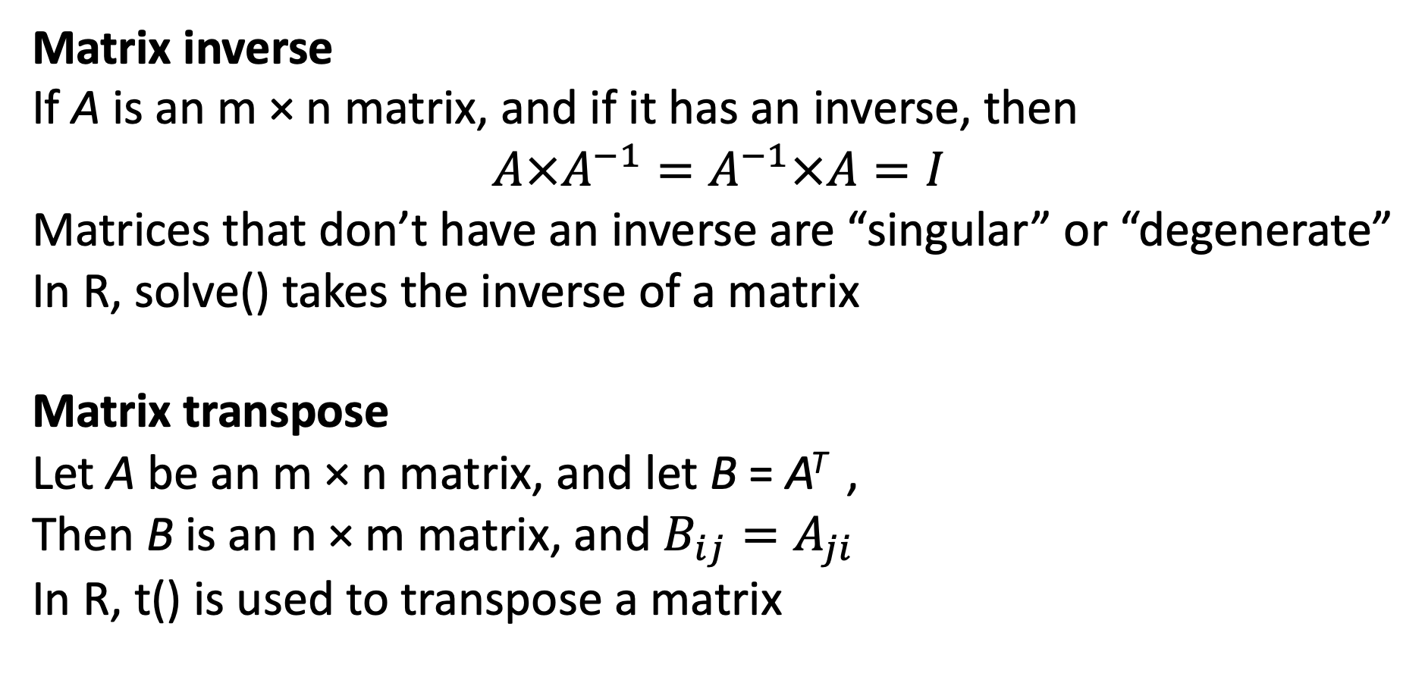
Inverse and transpose
Matrix inverse
If A is an m × n matrix, and if it has an inverse, then
$$A×A^{−1}=A^{−1}×A=I$$
Matrices that don’t have an inverse are “singular” or “degenerate”
In R, solve() takes the inverse of a matrix
Matrix transpose
Let A be an m × n matrix, and let B = A^{T} ,
Then B is an n × m matrix, and $B_{ij}=A_{ji}$
In R, t() is used to transpose a matrix

Slide 9
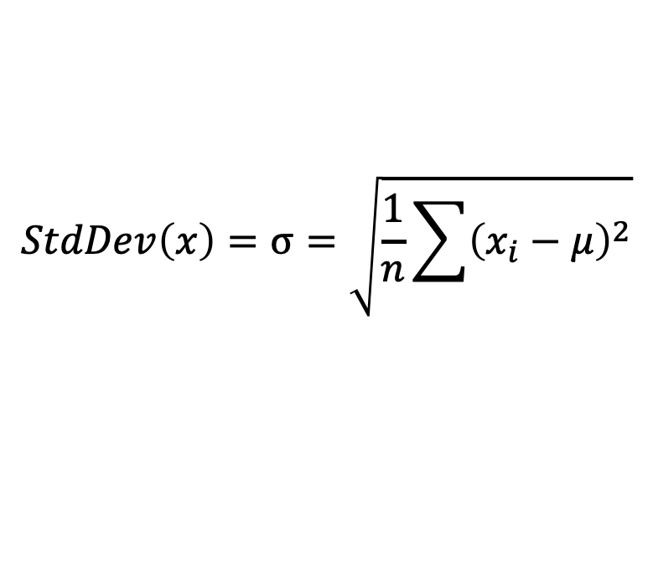
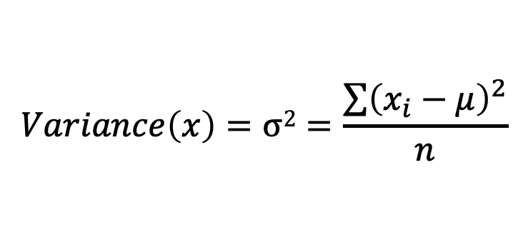
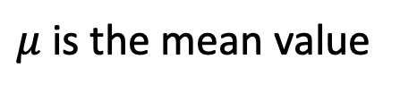
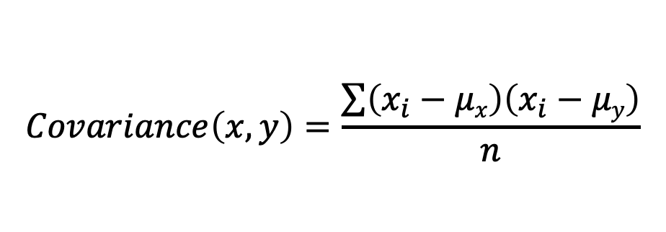
Standard deviation, Variance and Covariance
R functions
$$StdDev\left(x\right)=σ=\sqrt{\frac{1}{n}\sum{{\left(x_{i}−μ\right)}^{2}}}$$
sd()
$$Variance\left(x\right)=σ2=\frac{\sum{{\left(x_{i}−μ\right)}^{2}}}{n}$$
var()
$$Covariance\left(x, y\right)=\frac{\sum{\left(x_{i}−μx\right)\left(x_{i}−μy\right)}}{n}$$
cov()
$μ$ is the mean value

